Slide 1
The ribbon
The ribbon

Slide 2
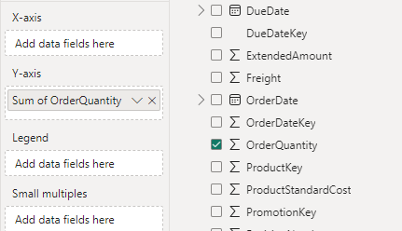
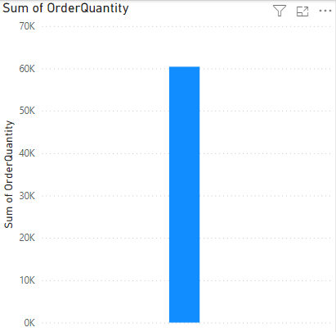
The ribbon
Add a ribbon to the scene and try to represent the quantity ordered field By adding on the Y axis
Note that he behaves Exactly like a battery Column

Slide 3
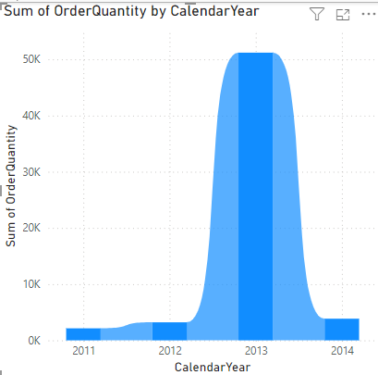
The ribbon
Add the Year field to the DimDate chart on the X axis and notice the visual behavior

Slide 4
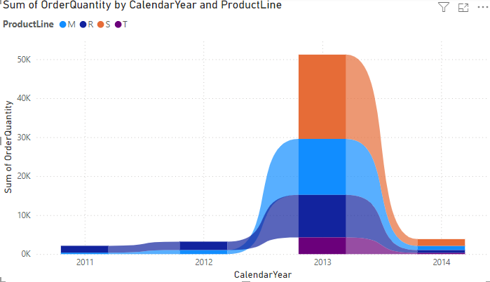
The ribbon
Now let's try to parse the data based on the ProductLine of DimProduct by adding it to the Caption parameter

Slide 5
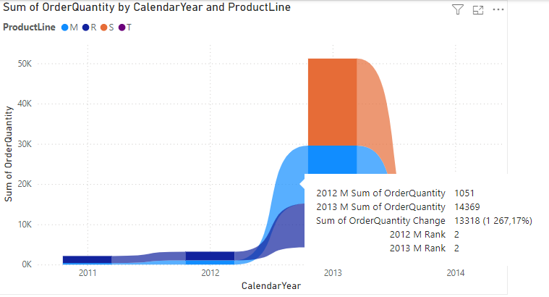
The ribbon
Try positioning the cursor on the first column, then between the first and second columns
Note that at the tooltip level you find the rank, also note the differential value of the quantities in addition to the values of the successive quantities

Slide 6
Thank you
Thank you

